Slide 1

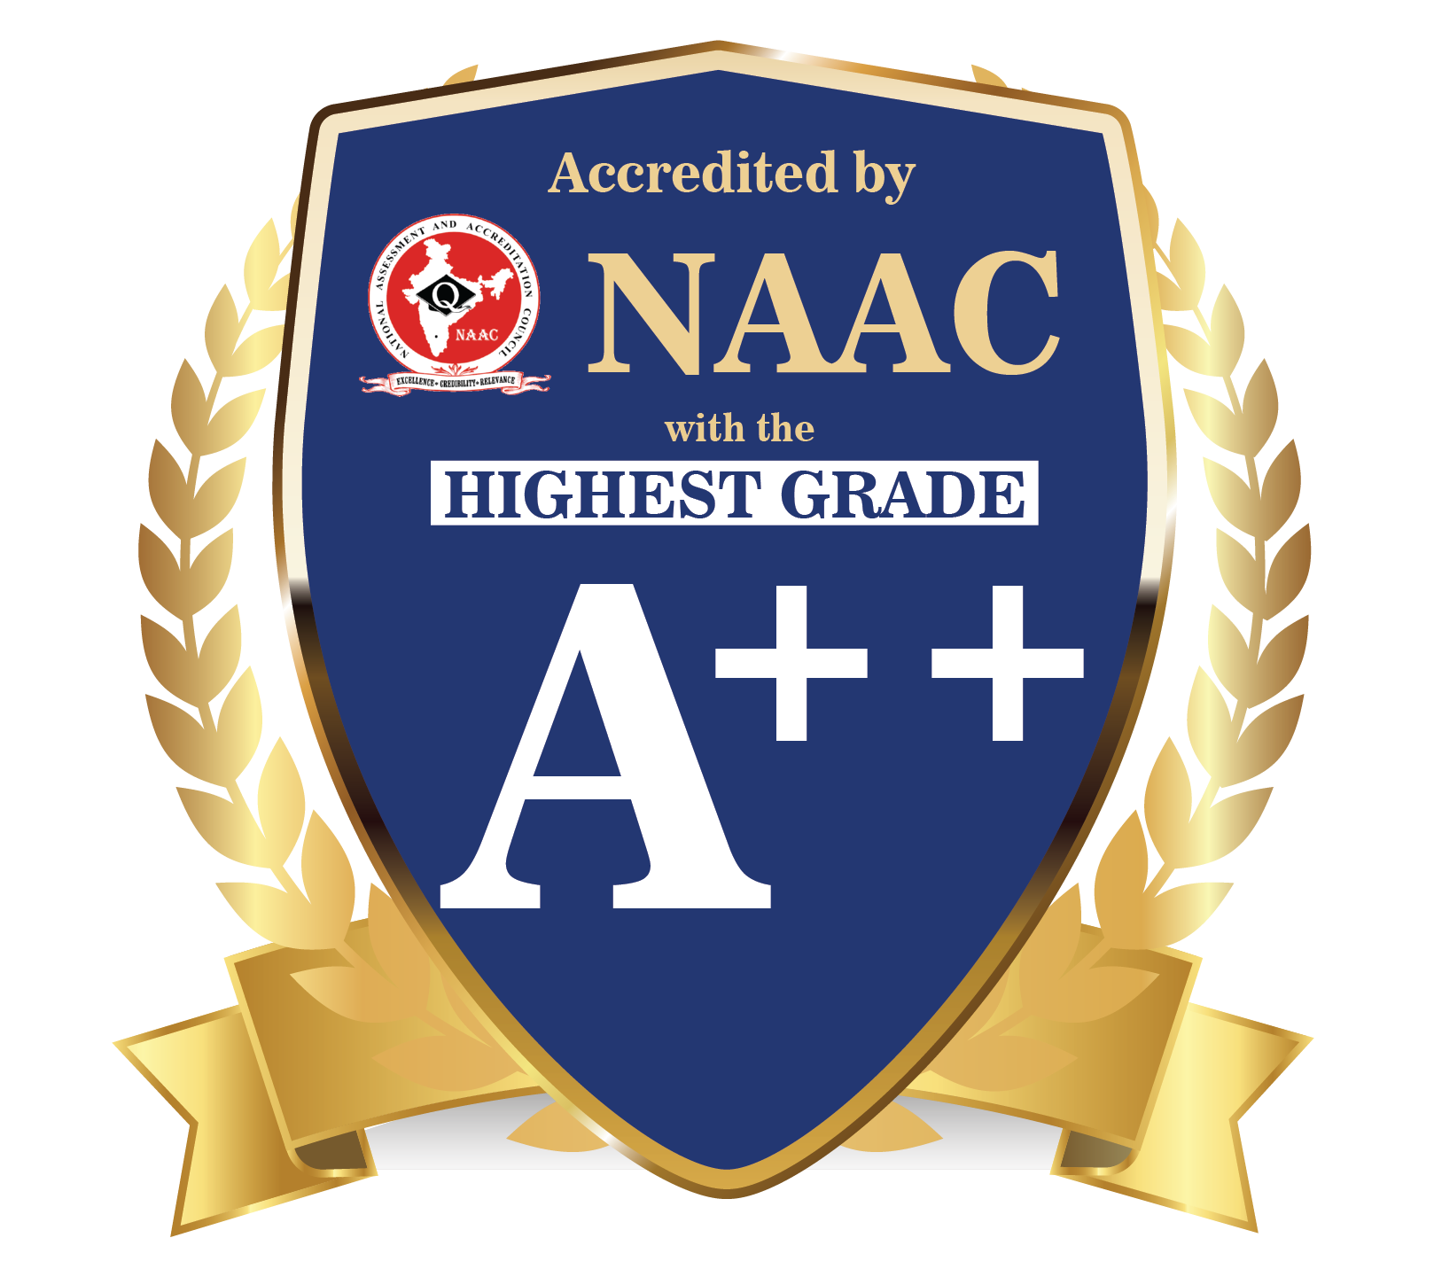
DEPARTMENT OF COMPUTER SCIENCE & ENGINEERING
SCHOOL OF COMPUTING
10214CS602 MINOR PROJECT –II INDUSTRY PROJECTS
WINTER SEMESTER(2023-2024)
SEMESTER END PROJECT VIVA VOCE EXAMINATIONS
“CHATBOT FOR HYDROPONICS”
SUPERVISED BY
PRESENTED BY
Dr.T.KAMALESHWAR, M.Tech., PhD.,
1.AMAN DEV (VTU19464)(21UECB0002)
2.SHREYA TIGGA (VTU19347)(21UECB0023)
3.STUDENT NAME (VTU 19486)(21UECM0338)

Slide 2
OVERVIEW
ABSTRACT
OBJECTIVE
INTRODUCTION
LITERATURE REVIEW (SOFT COPY OF PAPERS TO BE LINKED AS HYPERLINK)
DESIGN AND METHODOLOGIES
IMPLEMENTATION
TESTING
INPUT AND OUTPUT
INCLUDE DEMO VIDEO (You Tube URL of complete demonstration of project by All members as Voice over)
CONCLUSION
FUTURE ENHANCEMENTS
SOCIETAL IMPACT OF PROJECT
WEB REFERENCES LINK (TILL REVIEW DATE ALL LINKS TO BE INCLUDED DAY WISE)
PLAGIARISM REPORT OF PROJECT REPORT AND PPT
POSTER PRESENTATION
JOURNAL/CONFERENCE PUBLICATION PROOF
REFERENCES

Slide 3
ABSTRACT
Introduction The Hydroponics Chatbot project introduces an AI-driven solution for hydroponic farming, addressing the sector's unique challenges and opportunities.
Purpose: This project aims to develop a specialized chatbot to provide personalized guidance and recommendations to hydroponic farmers, leveraging AI technology and real-time data integration.
Method: Through AI algorithms and data integration, the chatbot engages users in natural language interactions, offering tailored crop management and decision-making advice.
Result: The Hydroponics Chatbot empowers farmers with accessible expertise, enhancing productivity and sustainability while promoting technology adoption and knowledge sharing.
Conclusion: This project marks a significant advancement in agricultural support, offering a valuable tool for driving progress and prosperity in hydroponic farming.

Slide 4
OBJECTIVES
Aim of the project:
This project aims to develop an AI-powered chatbot tailored for hydroponic farming, providing personalized support and advice to users while continuously improving its performance through machine learning techniques.
Scope of the project:
The scope of this project encompasses the creation of an intuitive multi-platform interface for seamless communication with the chatbot. It involves the integration of real-time data sources and the deployment of machine learning methods for ongoing performance enhancement. Additionally, the project entails building and maintaining a comprehensive hydroponics database and conducting usability testing to ensure an optimal user experience.

Slide 5
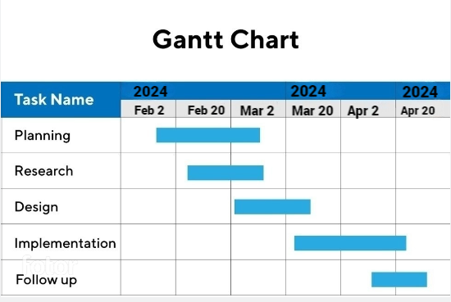
TIMELINE OF THE PROJECT

Slide 6
INTRODUCTION
“Imagine a world where hydroponic farmers have an expert advisor available 24/7, guiding them through every stage of crop cultivation. That's precisely the vision behind our groundbreaking project.“
Introduce the rising trend of hydroponic farming and its potential to revolutionize agriculture.
Highlight the challenges faced by hydroponic farmers in optimizing crop yields and sustainability.
Emphasize the importance of leveraging technology to overcome these challenges and drive innovation in agriculture.
Introduce the Hydroponics Chatbot project as a solution to empower farmers with personalized guidance and recommendations.
Mention the use of AI technology and real-time data integration to provide timely and relevant assistance.
Invite the audience to explore how this project aims to transform hydroponic farming practices and contribute to agricultural advancement.

Slide 7
LITERATURE REVIEW
Sl.No | Author’s Name | Paper name and publication details | Year of publication | Main content of the paper
1 | Lakshmi Sudha Kondaka; Ritvij Iyer; Shreyas Jaiswal. | A Smart Hydroponic Farming System Using Machine Learning | 2023 | Smart Hydroponic Farming System to grow various crops by maintaining and controlling environmental parameters.
2 | Chenchupalli Chathurya; Diksha Sachdeva; Mamta Arora. | Agriculture Chatbot(AGRIBOT)Using Natural Language Processing | 2023 | Agri-bot is a text-to-text chatbot which will help the farmers in answering the queries posed by them.

Slide 8
3 | Anushka Marla; Rejath Paul; Arupam Kumar Saha. | An AgroBot: Natural Language Processing Based Chatbot for Farmers | 2023 | TensorFlow-built chatbots can provide instantaneous assistance to producers.
4 | Ruaa Suliman Al-Gharibi | IoT-Based Hydroponic System | 2021 | The project concentrates on developing a hydroponic system based on internet of things technology to provide a flexible growing environment.

Slide 9
5 | Neelam Chandolikar; Chirag Dale; Tejas Koli. | Agriculture Assistant Chatbot Using Artificial Neural Network | 2022 | The problem can be solved by providing farmers with expert advice and relevant information (e.g. determine when to irrigate, how to sow seeds, and which pesticides to use effectively to increase the yields).
6 | Pravalika Reddy; Mohammed Sohel | An IoT Based Smart Hydroponics – Plant Automation BOT | 2024 | Present hydroponics farms require some human interactions. We propose an automation solution for these Hydroponics systems.

Slide 10
7 | Joshitha; P Kanakaraja;Kovur Sarath Kumar. | An eye on hydroponics: The IoT initiative | 2021 | The IoT system continuously monitors the farm and also displays the data with regards to the plant growth by which we can get the values of pH,water level, temperature, and humidity in the hydroponic reservoir.
8 | Mihir Momaya; Anjnya Khanna; Jessica Sadavarte. | Krushi – The Farmer Chatbot | 2021 | An Artificial Intelligence (Al) chatbot that assists the farmers by providing solutions to agricultural queries.

Slide 11
DESIGN AND METHODOLOGIES
MODULE 1:Data Collection Module
MODULE 2: Natural Language Processing

Slide 12
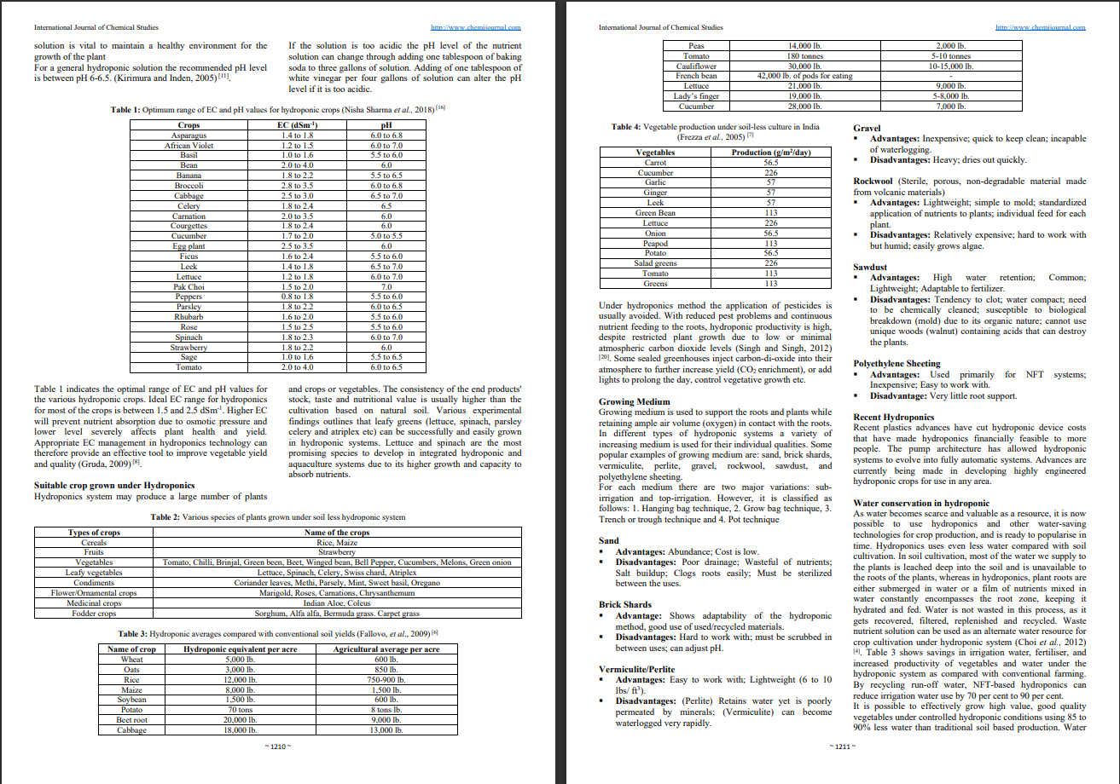
MODULE 1: Data Collection Module
Step:1 Collection of data

Slide 13
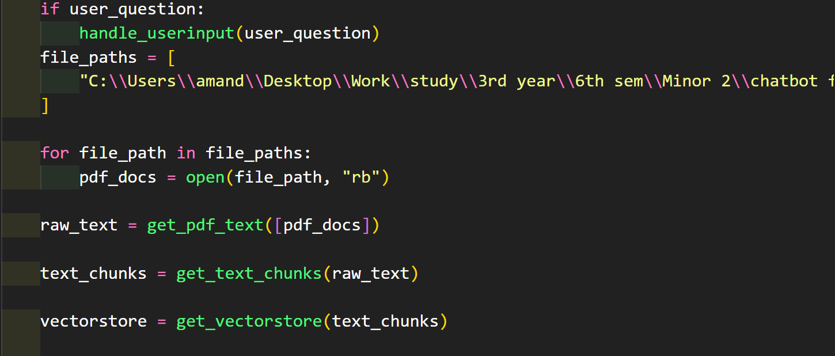
Step 2: Processing the data

Slide 14
Module 2-Natural Language Processing
1. Interpreting Human Language: NLP enables computers to understand and interpret human language, including both written text and spoken words.
2. Information Extraction: Through NLP techniques, computers break down text into smaller units and extract relevant information, such as identifying key words or phrases.
3. Linguistic Analysis: NLP algorithms apply linguistic rules and statistical models to analyze the structure and meaning of text data.
4. Tasks and Applications: NLP is used for various tasks, including sentiment analysis, named entity recognition, part-of-speech tagging, and machine translation.
5. Human-Computer Interaction: NLP facilitates natural interaction between humans and computers, powering applications such as chatbots, virtual assistants, and voice-controlled devices.
6. Data Processing: NLP processes large volumes of unstructured text data, enabling organizations to extract insights and derive value from sources like social media, customer reviews, and news articles.

Slide 15
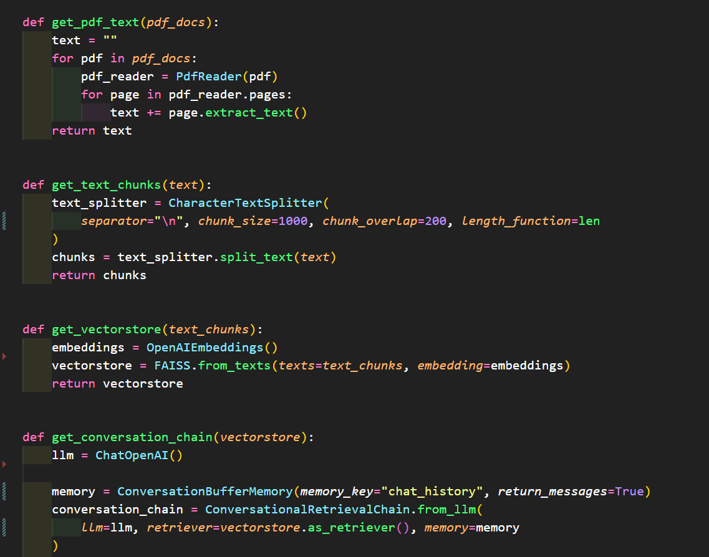
Step 3: Natural Language Processing

Slide 16
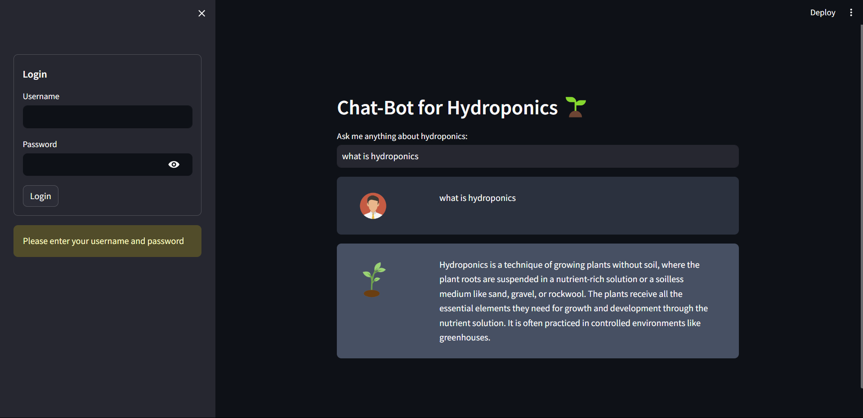
Step 4: The output

Slide 17
IMPLEMENTATION
Architecture Diagram
Data –Flow Diagram
Use Case Diagram
Class Diagram
Activity Diagram
Sequence Diagram
Collaboration Diagram(If applicable)
E-R Diagram
It’s a sample only and may vary according to the project

Slide 18
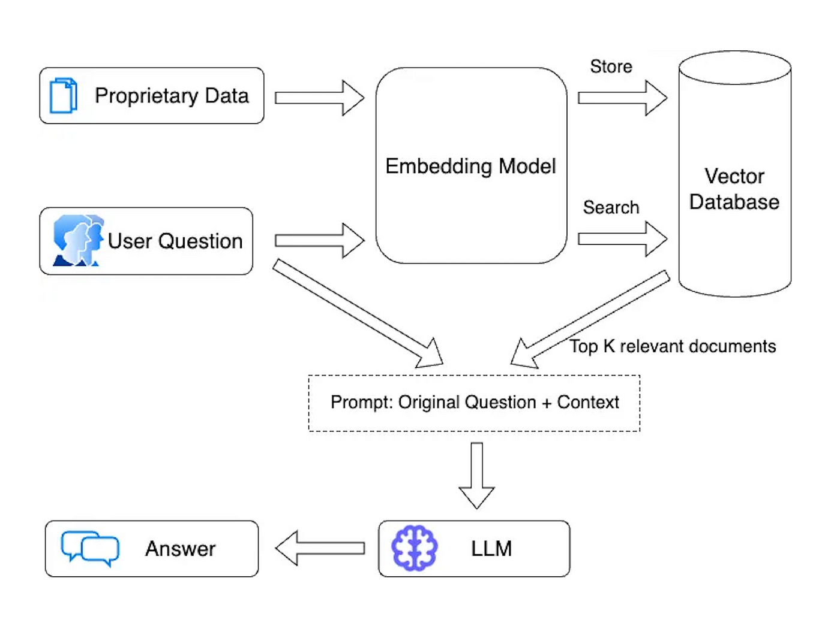
Architecture Diagram

Slide 19
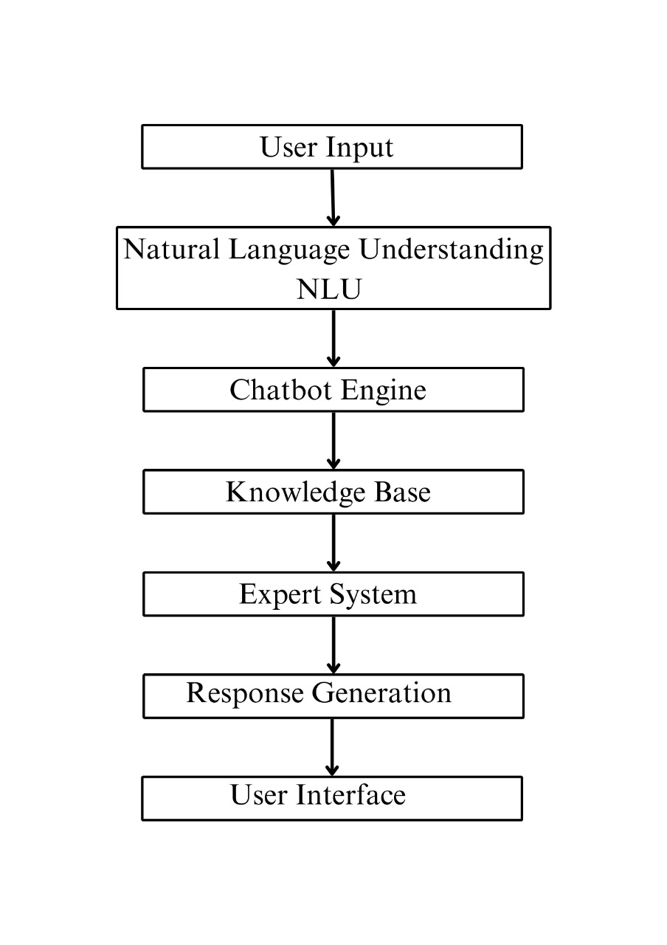
Data –Flow Diagram

Slide 20
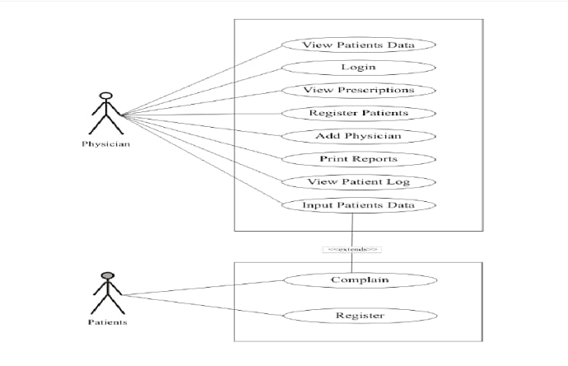
Use Case Diagram

Slide 21
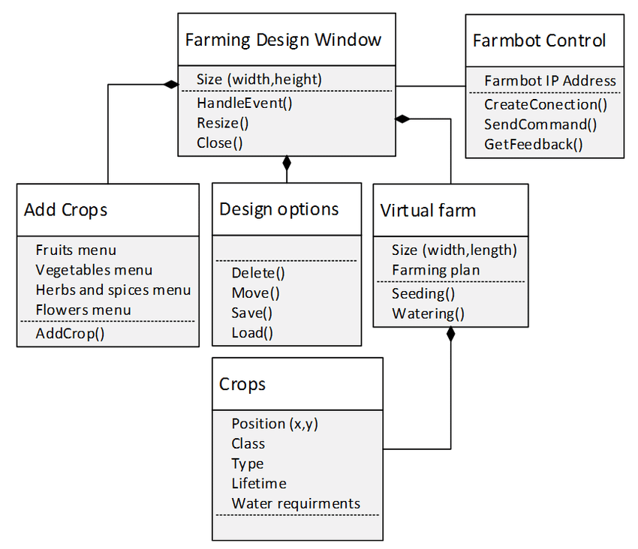
Class Diagram

Slide 22
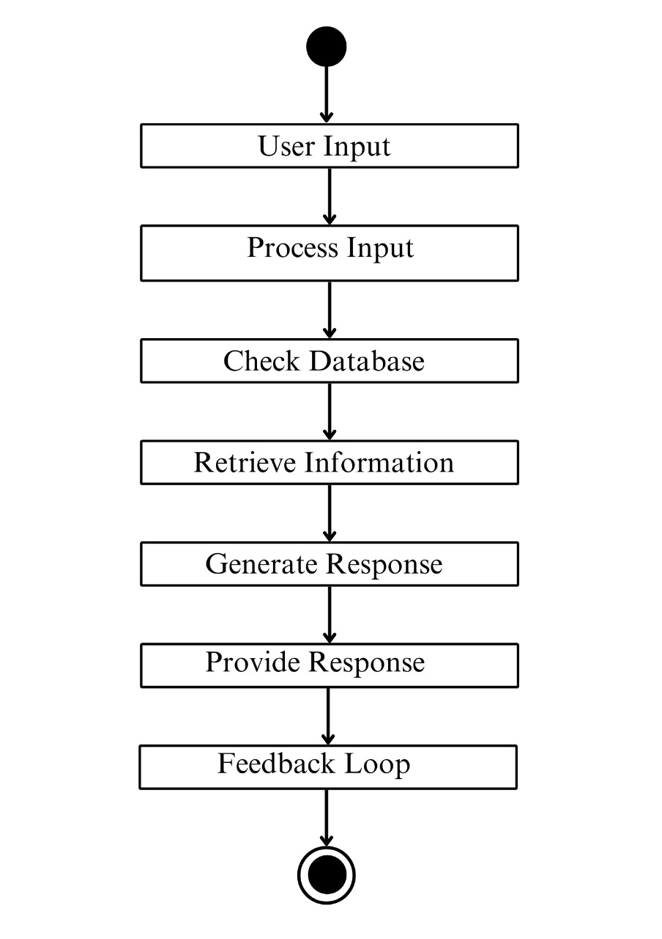
Activity Diagram

Slide 23
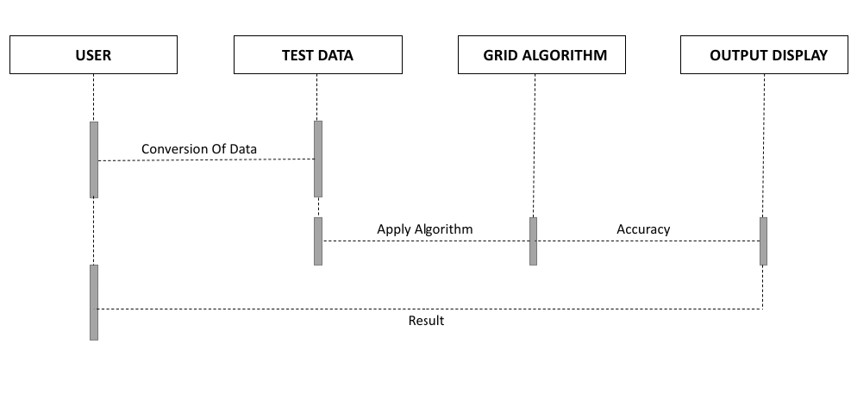
Sequence Diagram

Slide 24
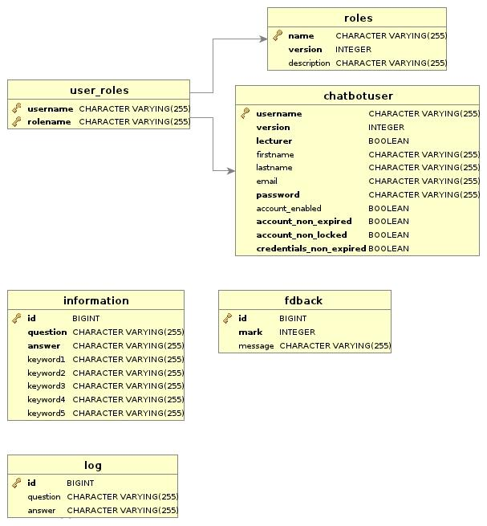
E-R Diagram

Slide 25
TESTING
UNIT TESTING
INTEGRATION TESTING
FUNCTIONAL TESTING
WHITE BOX TESTING
BLACK BOX TESTING

Slide 26
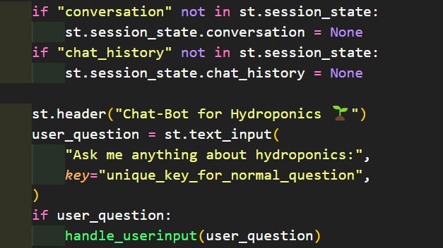
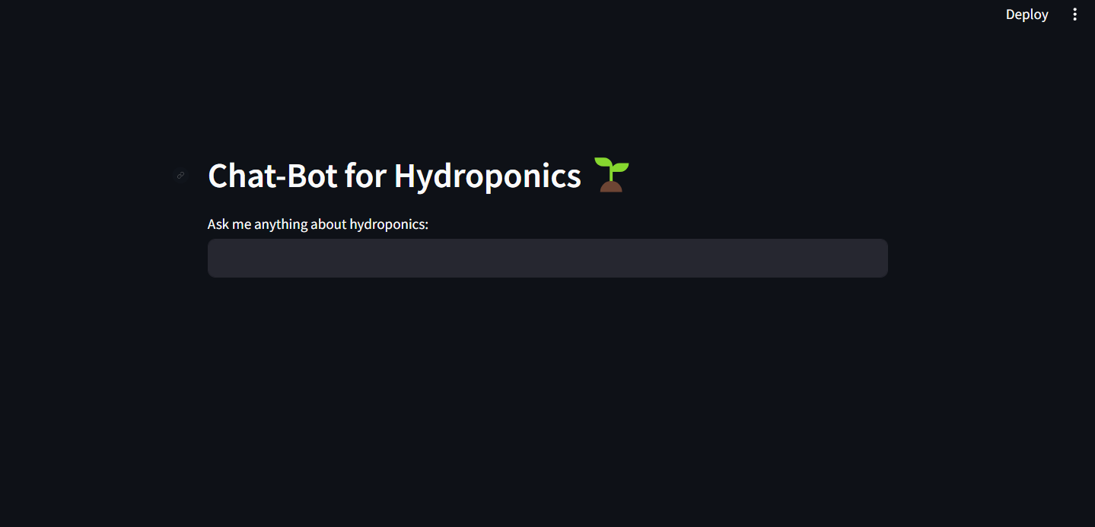
UNIT TESTING
INPUT:
OUTPUT:

Slide 27
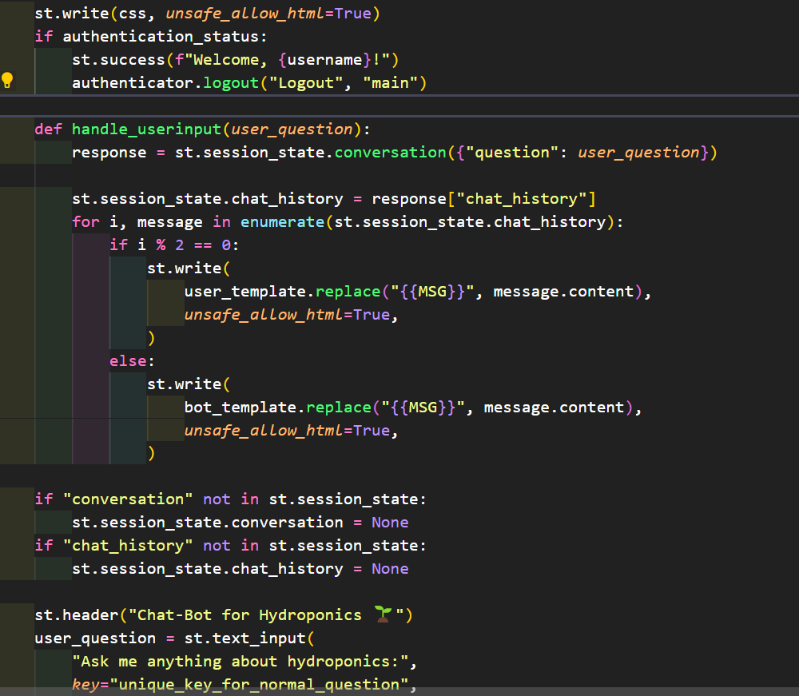
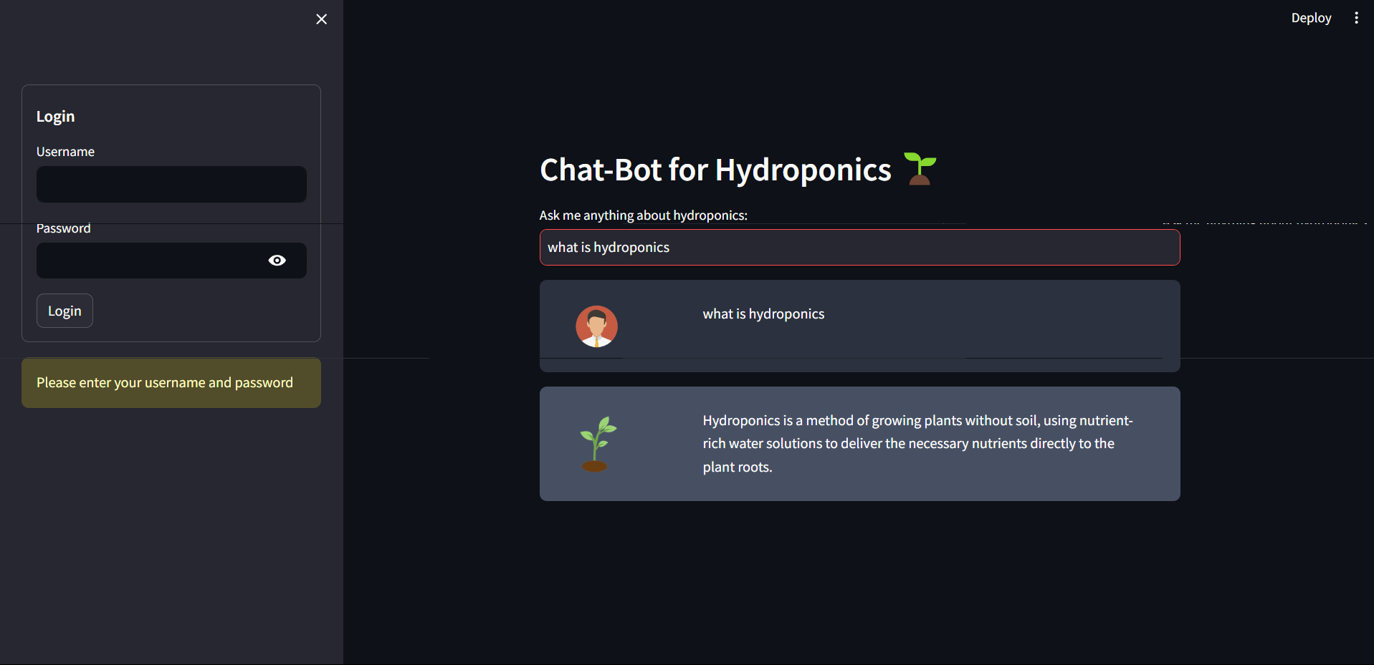
INTEGRATION TESTING
INPUT:
OUTPUT:

Slide 28
INPUT

Slide 29
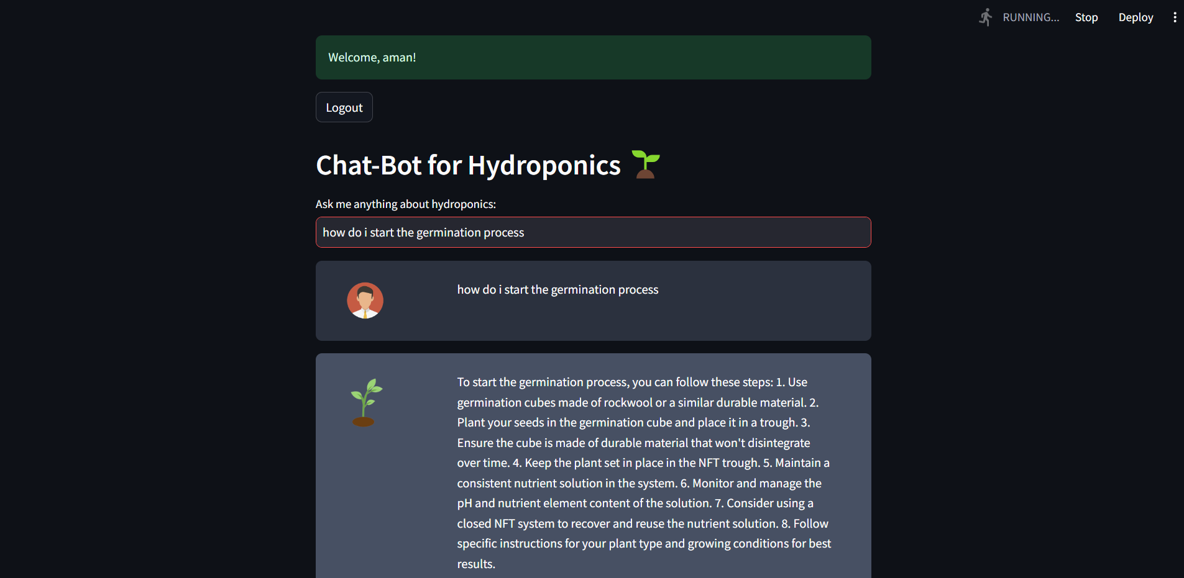
OUTPUT

Slide 30
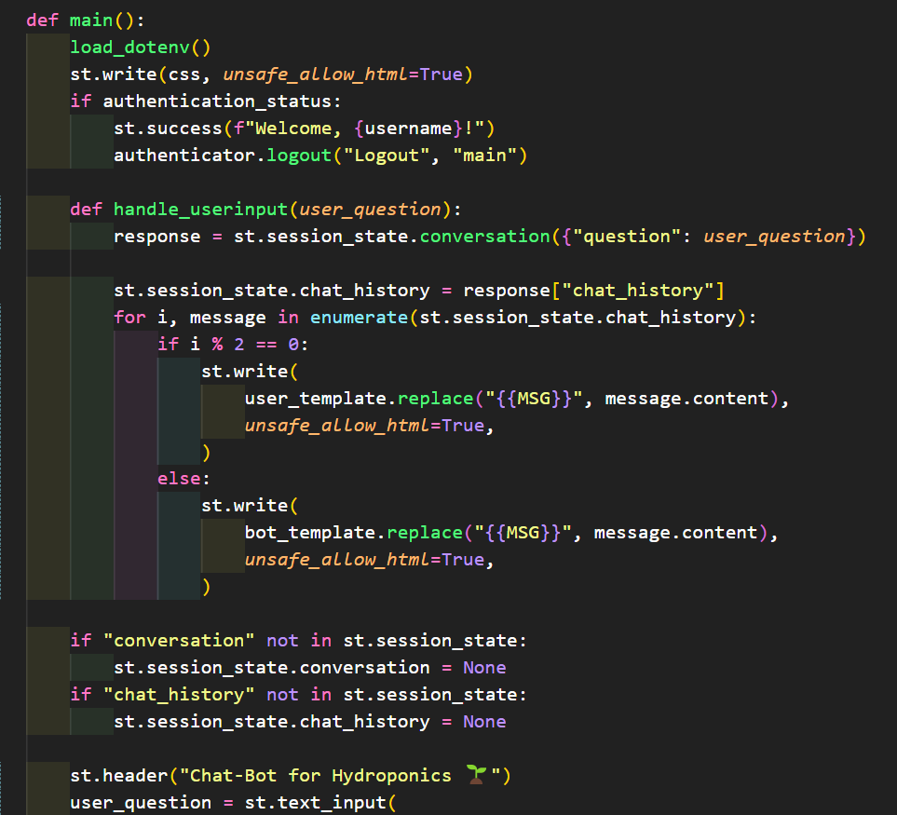
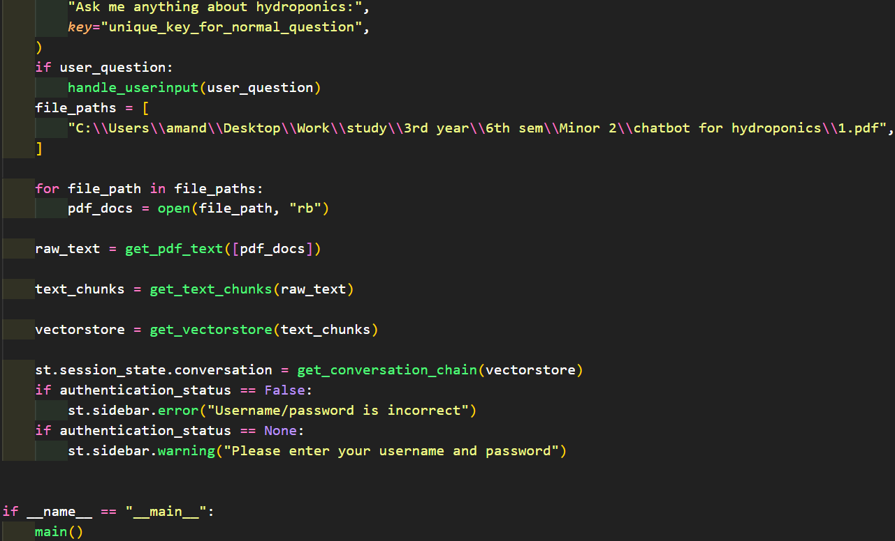
SOURCE CODE
It’s a sample only and may vary according to the project

Slide 31
OUTPUT

Slide 32
CONCLUSION
It has been accomplished by the Hydroponics Chatbot project to create a customized AI-powered solution for hydroponic farming.
The chatbot has successfully addressed the problem statement of helping hydroponic farmers maximize crop yields and sustainability by offering tailored advice and recommendations.
The chatbot has enabled farmers to easily accessible expertise, improving decision-making processes and encouraging the adoption of new technologies by utilizing AI technology and real-time data integration.
The project’s future goals include expanding into other fields like automated resource management and predictive analytics, as well as improving the chatbot’s algorithms even more.
In the end, the Hydroponics Chatbot project represents a noteworthy development in agricultural assistance, providing a useful instrument for promoting growth and success in hydroponic farming.

Slide 33
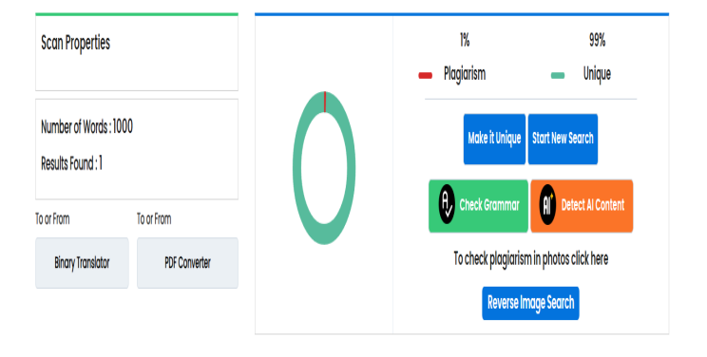
Plagiarism Report of PPT

Slide 34
Web references/video links
1. https://youtu.be/exAv7rlm7sc?si=ga6CYnGEO62ZFbW3.
2. R. Ahmed, "The Impact of TDS & pH on Quality of Drinking Water", Medium, 2021, [online] Available: https://medium.com/blueeast/tds-ph-and-their-impact-on-quality-of-drinking-water-68b2a7433043.Google Scholar
3. D. Martinez, "Light Wavelengths: Does Your Grow Light Have What You Need for Your Next Harvest?", 2020, [online] Available: GrowAce.com.Google Scholar
4. https://youtu.be/EBn9UbtcsIE?si=EnQbM-I51SjRuRt0

Slide 35
REFERENCES
[1] "5 Reasons Hydroponic Growing is More Profitable Than Soil Growing", 2017, [online] Available: Rimolgreenhouses.com.
Google Scholar
[2] R. Ahmed, "The Impact of TDS & pH on Quality of Drinking Water", Medium, 2021, [online] Available: https://medium.com/blueeast/tds-ph-and-their-impact-on-quality-of-drinking-water-68b2a7433043.
Google Scholar
[3] D. Martinez, "Light Wavelengths: Does Your Grow Light Have What Your Need for Your Next Harvest?", 2020, [online] Available: GrowAce.com.
Google Scholar
[4] J. Dobbin, "Lag! Top 5 Reasons your Ping is so High", 2020, [online] Available: Hp.com.
Google Scholar
[5] "How to Save Brown Tipped Plants", [online] Available: Pennington.com.
Google Scholar
[6] J. King, "The History of Greenhouses", 2020, [online] Available: Blog.growlink.com.
Google Scholar

Slide 36
[6] F. Kalantari, O. Tahir, R. Joni and E. Fatemi, "Opportunities and Challenges in Sustainability of Vertical Farming: A Review", Journal of Landscape Ecology, vol. 11, no. 1, pp. 3560, 2018.
CrossRef Google Scholar
[7] Melchizedek I. Alipio, "A smart hydroponics farming system using exact inference in Bayesian network", 2017 IEEE 6th Global Conference on Consumer Electronics (GCCE).
Google Scholar
[8] Manav Mehra, "IoT based hydroponics system using Deep Neural Network", Computers and Electronics in Agriculture, vol. 155, pp. 473-486, December 2018.
Google Scholar
[9] C. J. G. Aliac and E. Maravillas, "IOT Hydroponics Management System", 2018 IEEE 10th International Conference on Humanoid Nanotechnology Information Technology Communication and Control Environment and Management(HNICEM), 2018.
Google Scholar
[10] "Hydroponics as an advanced technique for vegetable production: An overview Nisha Sharma", Journal of Soil and Water Conservation, January 2019.

Slide 37
THANK YOU

